Slide 1
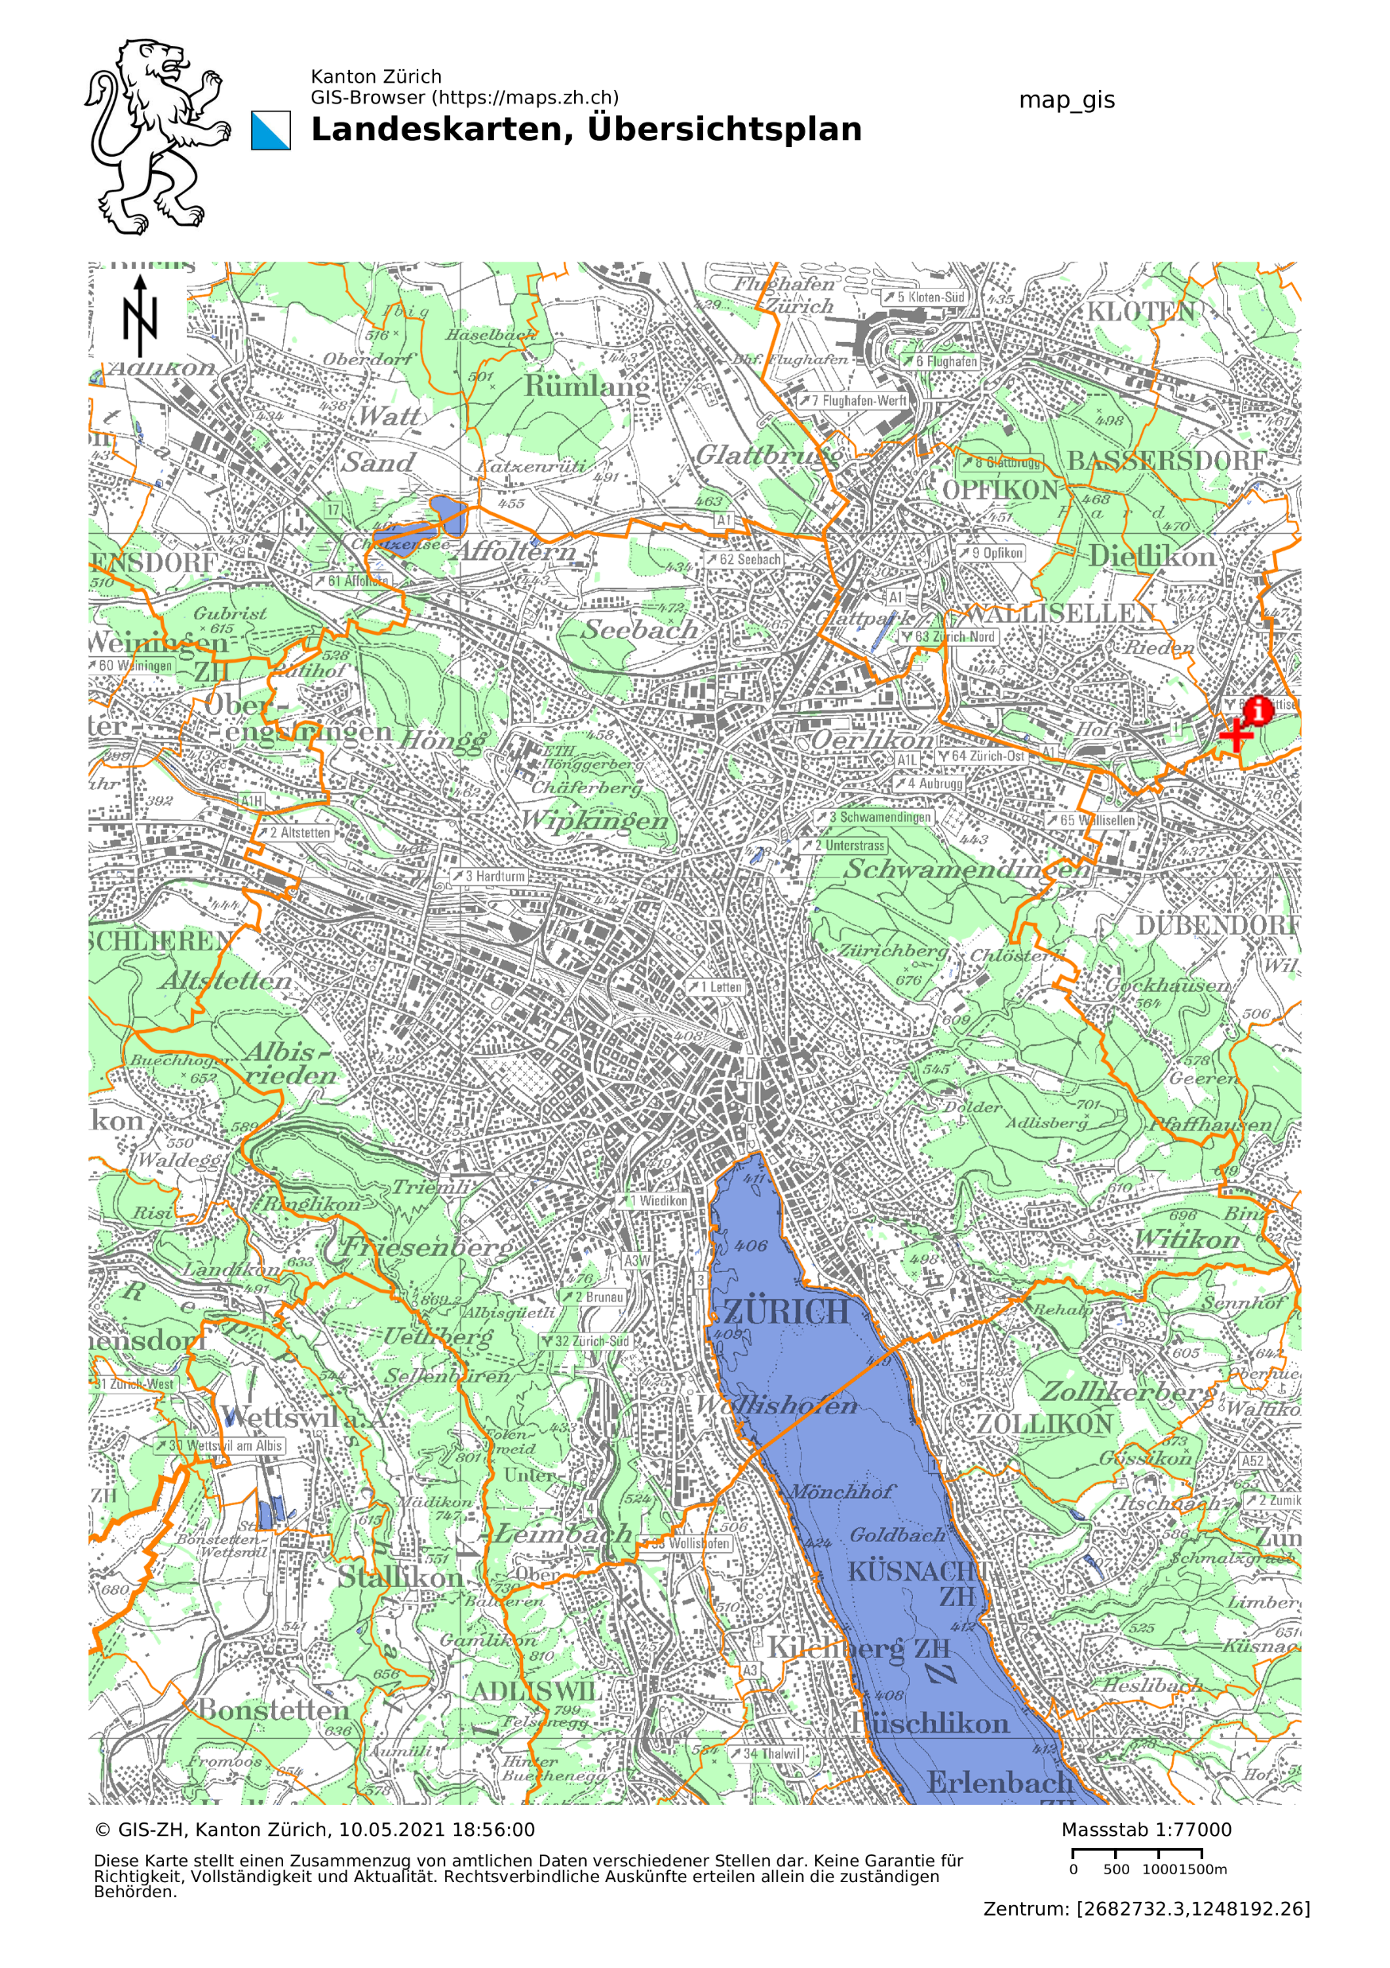
Introduction to Data Science Project Accident Analysis in Zurich David Linder, Marcelo Looser

Slide 2
Content
Introduction
Data preparation
Exploratory analysis
Results
Questions

Slide 3
Introduction
Questions that we tried to answer:
Which features in the data set are significant when accidents occur, correlations?
Can we classify certain features in dependence of a subset of other features?
Can we find the underlying probability distribution of the samples?
and what do they tell us?

Slide 4
Data preparation
The given data sets are quiet messy.
The goal is to clean up all the data sets and save them in destinct tables.
Link them by certain features.
With additional merging in a separate table.

Slide 5
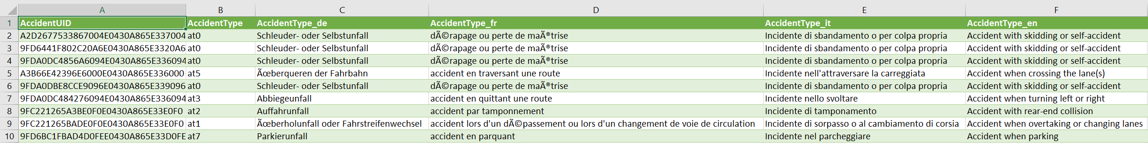
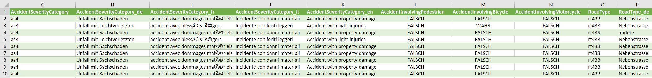
Data preparation, accidents in Zurich
Drop unimportant columns

Slide 6
Data preparation
Change strings to integer, and change false/true statements to 0/1

Slide 7
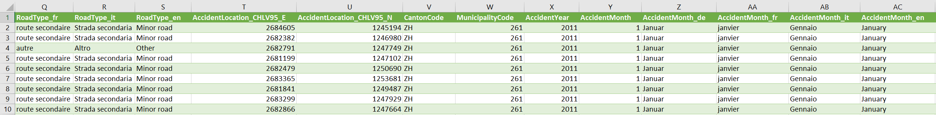
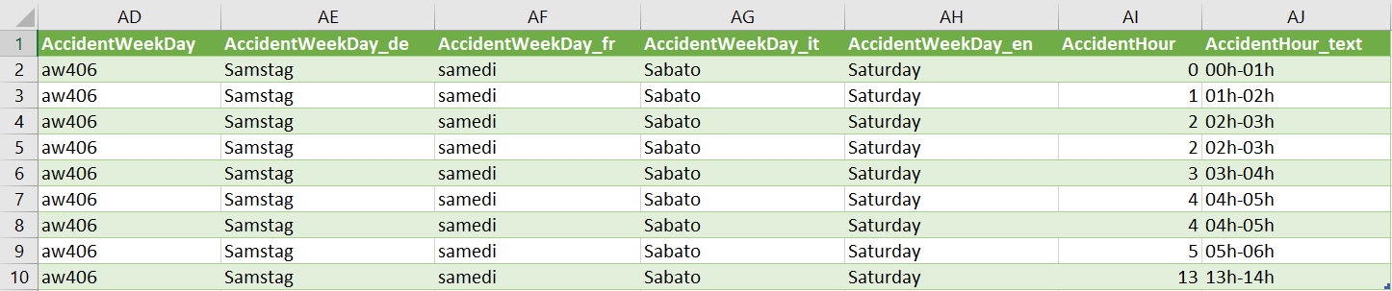
Data preparation
Merge date objects to one column called Date

Slide 8
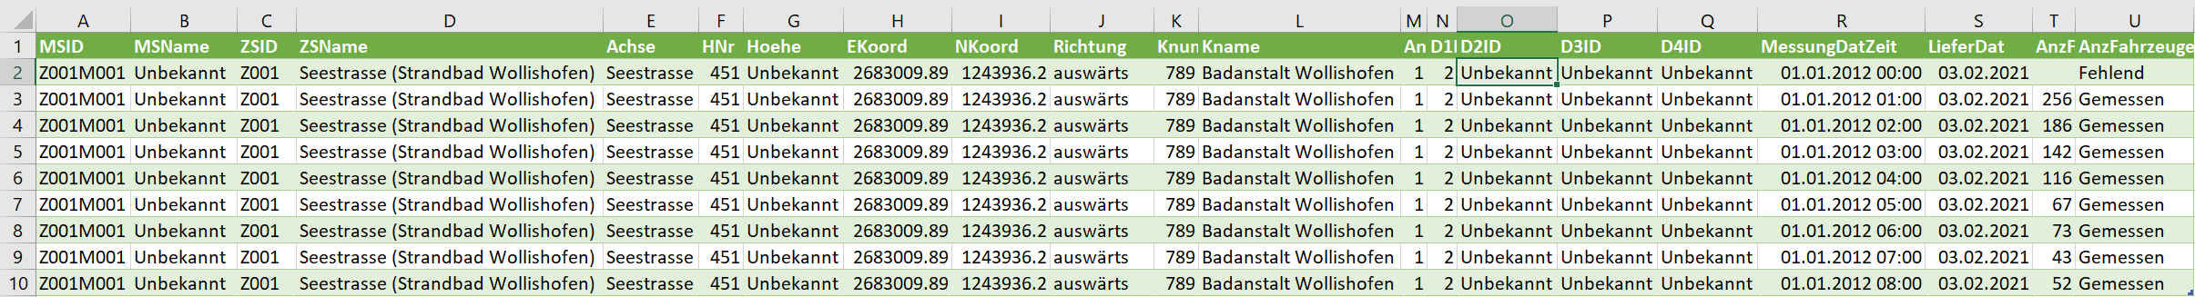
Data preparation, counts of cars on the road
Drop unnecessary columns

Slide 9
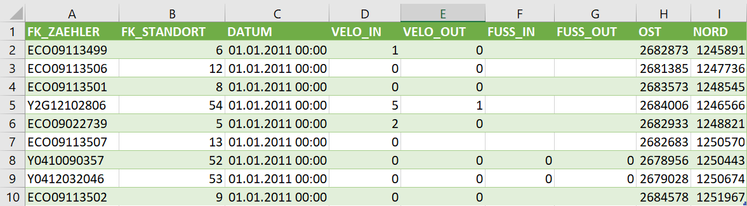
Data preparation, counts of pedestrians and bysicles on the road
Drop unnecessary columns

Slide 10
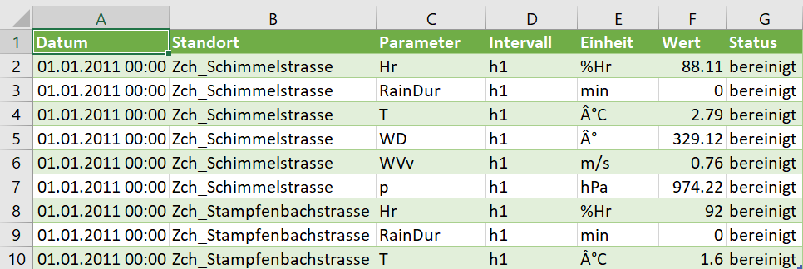
Data preparation

Slide 11
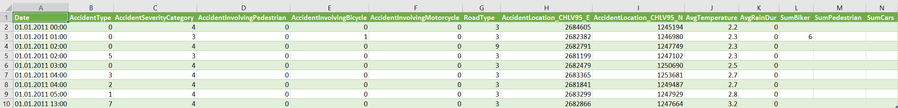
Data preparation

